Slide 1

Caliber 2020 Hackathon Submission
Team Name : ECLPS
Members:
Keerthika S (568844)
Lakshmi Priya S (663893)
Manikandan J (761106) _(POC)
Senthil Nagalakshmi D (710917)
Srikanth M (749524)

Slide 2
Disclaimer
This end to end single page master web application is created from scratch by our team. We use many open source technology and frameworks for developing the project

Slide 3



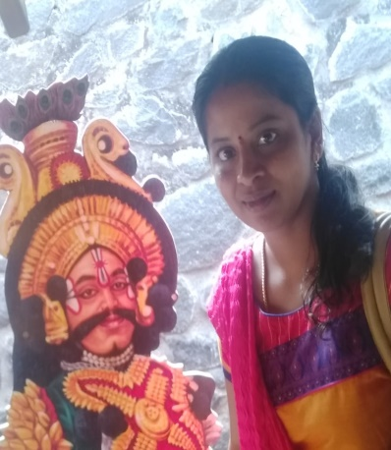
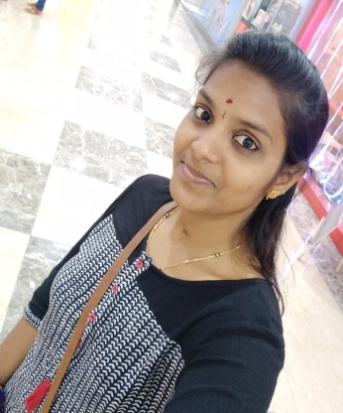
Team Introduction
.
Lakshmi
Manikandan (MJ)
Sri
Keerthi
Naga Lakshmi

Slide 4
VM Details IP:10.0.0.188
VM Name: ECLPS-vm
Password: azure@2020
Instruction to excute code:
1)Running Client Side (Angular app)
Open Visual Studio Code.
Open integrated Terminal in Visual studio code.
Type “cd C:\Users\calibone\Documents\HostMyPartyAngular\host-my-party”.
type “ng s –o”.
Application is open in browser.(http://localhost:4200/Login) will open
2) Running Server side(Spring boot app)
You can see spring boot icon in task bar, double tap it.. Spring boot will open
Click Ok for default work space and you can see the “hostmyparty” spring boot app
right click it and run as → Spring boot app…It take few seconds and You will see Application is started” in console
Now You can Use “Host My Party” in browser ☺.

Slide 5
Description
We people always wants to celebrate our wonderful moments in life.
For celebration ,we arrange parties, invite more people and organize the event.
Organizing events are big tasks, to solve this complexity we built an end to end Master Web app called “HostMyParty” ,By this app we organize events easily.
By this app you can search for services like Marriage or party hall, Chefs ,photo and videographers ,bakery services and Event Managers etc.,
So by using this app we have more time to celebrate with friends and hosting the party is simple
There are more than 20 end to end working functionalities.
We use REST for communication between Server Side(Spring boot Frame work) and Client Side(Angular 9 framework)

Slide 6








Technologies :
Front End: Angular9,TypeScript,JS,Bootstrap
MiddleWare: Java,SpringBoot,JPA
TransferMechanism: Representational State Transfer API’s
Backend: MySQL

Slide 7
Roles and Functionalities
Functionalties:
1)Login
2)Registration
3)Search for Services
4)Update Profile
5)View Profile
6)Set Activity Status(not for user)
7)Book Services
8)Add Wallet
9)Update Service Info(not for User)
10)Accept booking request(not for user)
11)View booked history
Roles:
1)User
2)Hall Service,
3)Camera/Video Graphy Service,
4)Chef
5)Event Managers
6)Bakery

Slide 8
Functional Architecture
Vendor(Hall, Event Manager, Chef, Photo videographers, Bakery)
User
Login
Accept/
Reject
Proposal
Search
View Profile
Add wallet
Book vendor
Registration
Update
Vendor info
View history
Logout
Notification
View vendor Profile
Set Status

Slide 9
Project Architecture
DataBase
Repository
Layer
REST
Controller
Angular REST
Services
Because of this Our Layered Architecture , The entire application is loosely coupled so we can modify the changes easily in future
Data
Services
Service
Layer
Interface
Layer
Angular Components

Slide 10
For Database Schema architecture ,Please find SQL Text file

Slide 11
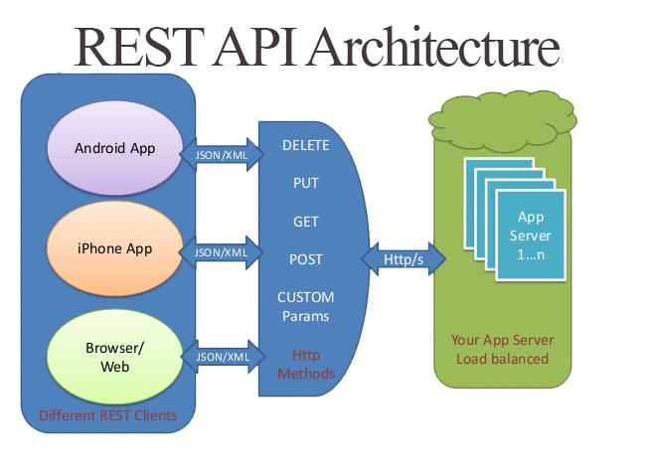
REST CALLS
We use Rest Api’s to cross origin the server and client side url ,
In Server side:
we use “Controller Layer”
(find in our Spring boot app)
In Client side
we user “Services”
(find in our Angular app)
We use JPA for handling Entities in
Database(JPA Repository)

Slide 12
Future Road Map
Because of our totally layered application we can easily add/remove services in this application
Future services:
Using Azure Chat bots for user friendly
Book Random parties around the area
Adding Map API for Location
Using Azure SQL Servers
Using Payments Gateways
Converting Monolithic to Micro service Architecture
Accommodate Azure Web services

Slide 13
Please see the application working demo video attached along with is presentation ☺

Slide 14
Enjoy the Party
<h1>Thank you</h1>
System.out.println(“Thank you”);
Console.log(“Thank you”);
Print(“Thank you”);
printf(“Thank you”);
{{Thank You}}

